Slide 1

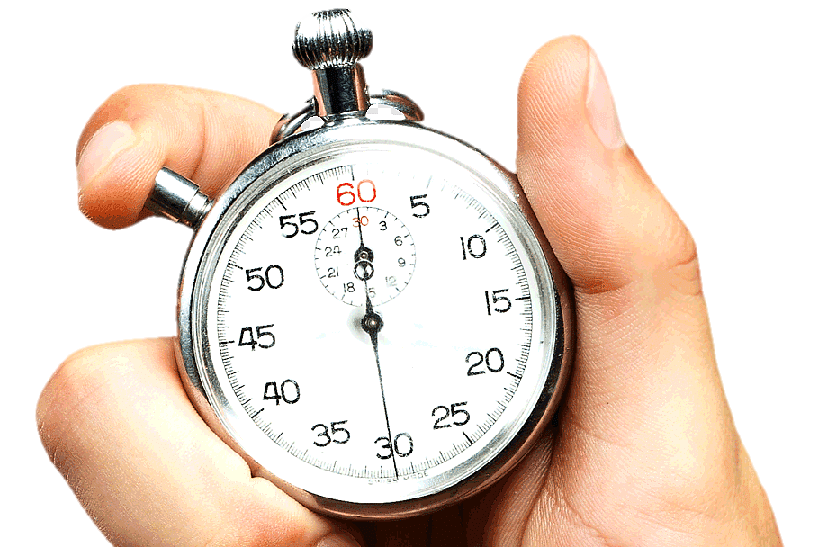

NY Taxi Trip Duration Prediction

Slide 2
PROBLEM STATEMENT

Slide 3
PROBLEM STATEMENT
To build a model that predicts the total ride duration of taxi trips in New York City.
This will help in placing the taxis at the right places at the right time thereby reducing the waiting time for customers.

Slide 4
Trip Duration= Distance/Speed

Slide 5
Factors That Might Affect the Trip Duration
Location Based
Features
Trip Details
Driver Details
Time Based
Features
Taxi Details
Random Factors

Slide 6
Location Based Features-
Pickup Point (Latitude & Longitude) - There might be some correlation between the drop-off latitude and longitudes and the trip-duration
Drop-off Point (Latitude & Longitude) - There might be some correlation between the drop-off latitude and longitudes and the trip-duration
Pickup Region - The Area from which the passenger was picked up might impact the trip duration
Drop-off Region - The Area in which the passenger was dropped might impact the trip duration as well

Slide 7
Time Based Features-
Date - On weekends, the trip duration might be lesser as compared to weekdays
Time - During office hours, the trip duration might be more as compared to others Late night trips might be of shorter duration due to lesser traffic
Public Holiday - If there is a public holiday, the trip durations might be lesser due to minimum office traffic
Season - Winters might have more trip durations than Summers

Slide 8
Trip Details
Car Pool (Y/N) - A Pooled Car might have longer trip duration
Intercity/Intracity - An Intercity Trip would have longer trip duration then Intracity
No. of Passengers Travelling – Higher the number of passengers, longer would be the trip duration

Slide 9
Taxi Details
Year Bought - If the car was recently bought, it would perform better, hence less Trip Duration
Last Service - If the car was serviced recently, it will perform better, hence less trip Duration
Condition (Rating out of 5) - Higher the Rating, Lesser would be the Trip Duration
Brand of Car - A Luxury Brand might be used for longer trips whereas a normal would be used for shorter
Type of Car - A Hatchback car might have lesser trip duration than a SUV

Slide 10
Driver Details
Age- More the age, lesser might be the speed, more would be the trip duration
Experience - More is the years of experience, lesser would be the trip duration
Gender - A Male Driver might take lesser time than a Female Driver to reach a particular destination
Medical Condition (Y/N) – A Driver with some medical conditions will take more time to reach a destination

Slide 11
Random Factors
Weather - Rains/Snow/Hail would increase the trip duration
Emergency (Y/N) - In case of emergencies, the trip duration might be lesser
Accident (Y/N) - If our taxi got involved in an accident, the trip duration might increase drastically and also indefinitely
Car Fault (Y/N) - If there is some fault in our taxi, for e.g.:- a tyre puncture, the trip duration might increase

Slide 12
THE DATASET

Slide 13
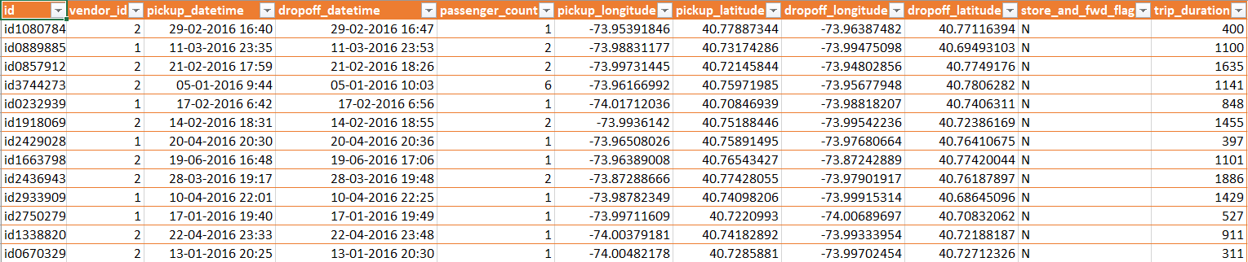
THE DATASET
It has 729322 rows and 11 columns.

Slide 14
THE DATASET
ID
PICKUP_DATETIME
PICKUP_LONGITUDE
PICKUP_LATITUDE
VENDOR_ID
DROPOFF_DATETIME
DROPOFF_LONGITUDE
DROPOFF_LATITUDE
PASSENGER_COUNT
STORE_AND_FWD_FLAG
TRIP_DURATION

Slide 15

THE DATASET
ID
PICKUP_DATETIME
PICKUP_LONGITUDE
PICKUP_LATITUDE
VENDOR_ID
DROPOFF_DATETIME
DROPOFF_LONGITUDE
DROPOFF_LATITUDE
PASSENGER_COUNT
STORE_AND_FWD_FLAG
TRIP_DURATION

Slide 16
FEATURES ENGINEERED

Slide 17
FEATURES ENGINEERED
DISTANCE
AVG_SPEED
PICKUP_DAY_NAME
DROPOFF_DAY_NAME
PICKUP_TIME
DROPOFF_TIME
PICK_TIME_FRAME
DROP_TIME_FRAME

Slide 18
UNIVARIATE ANALYSIS

Slide 19
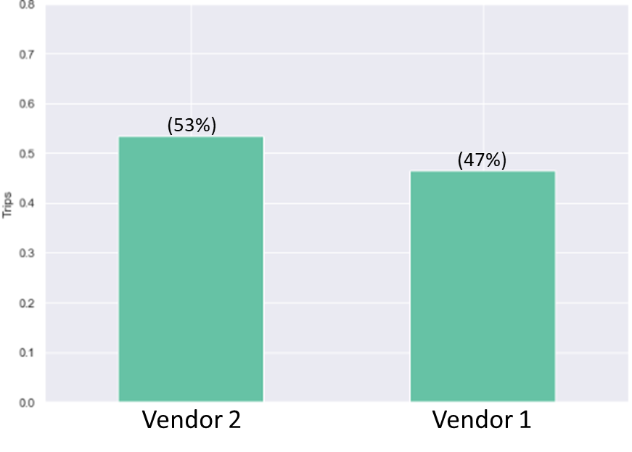
Vendor ID
-Vendor 2 is the preferred Vendor

Slide 20
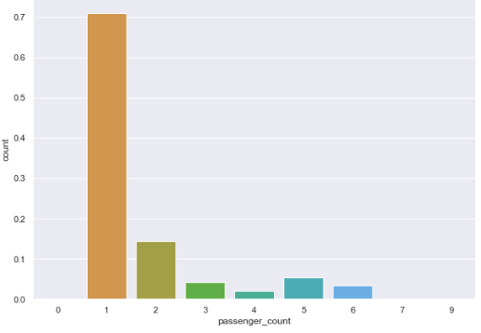
Passenger Count
71%
14.5%
-Most rides have only one passenger
-We have anomalies of 0,7 and 9 passengers.

Slide 21
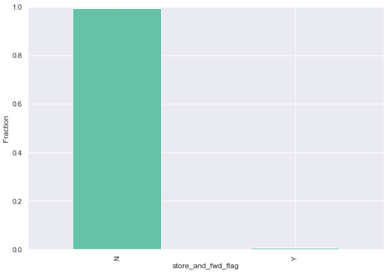
Store and Forward Flag
99.45 %
0.55%
N
Y
-Majority of rides did not have any internet connection problems
Notes:
99.45 % of rides did not have any internet connection problems
Very less instances of flag being stored took place and could be because of reasons like
Loss of signal
Battery issues
Inconsistent signal reception

Slide 22
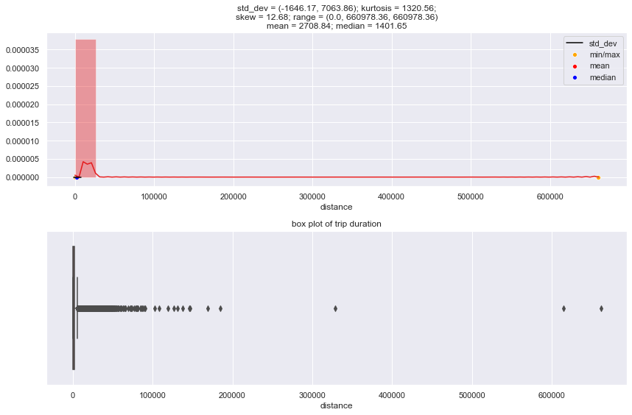
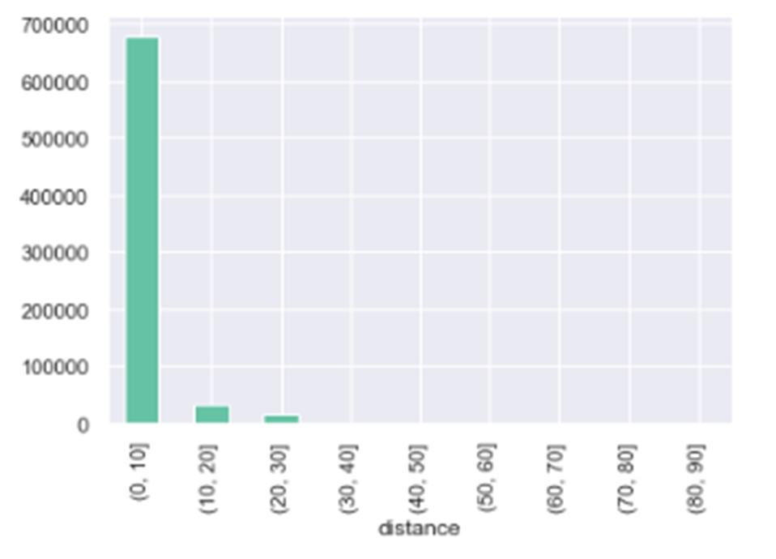
Distance
-We have anamolies of 0 km and trips with more than 100 kms
-Most of our trips are between 0 and 10 kms, some between 10 to 30Kms.
Notes:
99.45 % of rides did not have any internet connection problems
Very less instances of flag being stored took place and could be because of reasons like
Loss of signal
Battery issues
Inconsistent signal reception

Slide 23
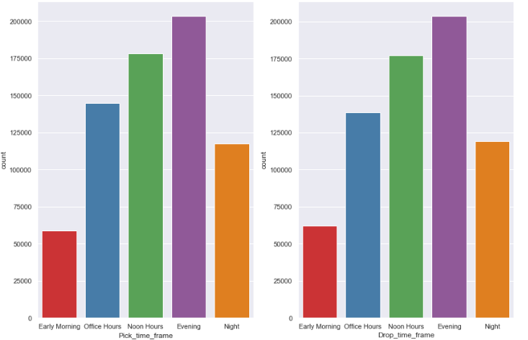
Pick_Time_Frame
Drop_Time_Frame
-Highest number of Trips in the Evenings
-Least at Early Mornings
Notes:
Afternoons & Evenings have the highest number of trips
There are least number of trips in the morning

Slide 24
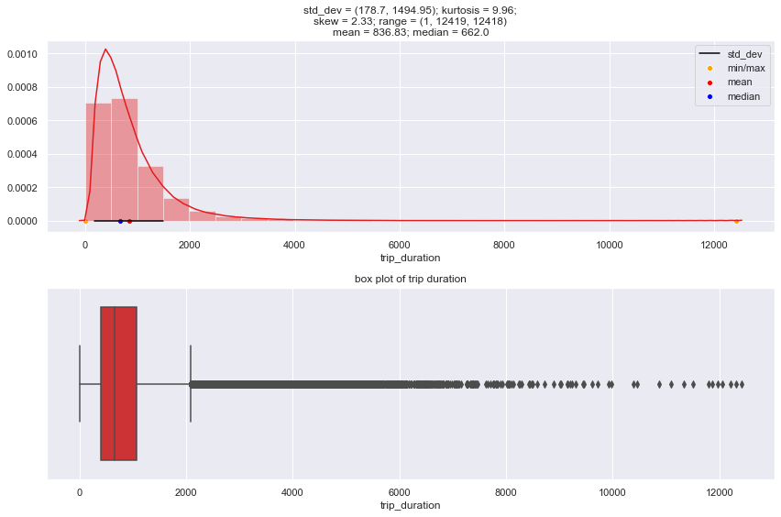
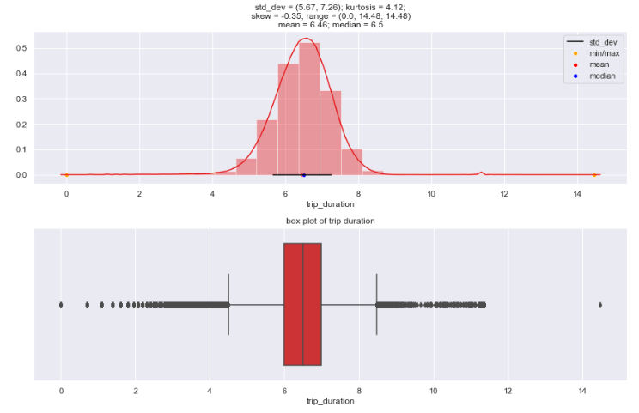
Trip_Duration (log transformed)
Trip_Duration
Notes:
On Log Transforming, we see that our kurtosis decreases, and our skewness is almost 0.
Hence, our trip_duration follows a lognormal distribution.

Slide 25
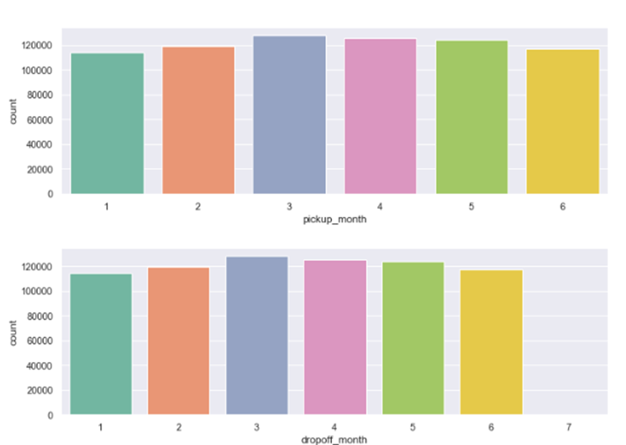
Pickup and Dropoff_Month
-Maximum number of trips take place in March
-Trips increase from Jan to March and then decrease
Notes:
Our number of trips gradually increase from Monday to Friday. There seems to be a significant drop in number of trips made on Sunday.

Slide 26
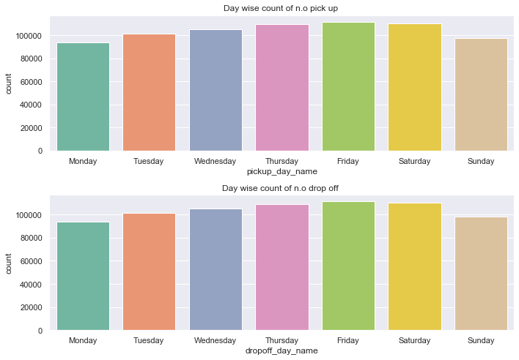
Day Wise Pickup and Dropoff
-Number of trips increase from Monday to Friday
-There is drop on the weekends
-Weekdays are busier than Weekends
Notes:
Our number of trips gradually increase from Monday to Friday. There seems to be a significant drop in number of trips made on Sunday.

Slide 27
Summary of Univariate Analysis-
1. Vendor 2 has significantly more number of trips than Vendor 1.
2. Around 73% of the trips have only one passenger with some anomalies of 0, 7, 9 passengers.
3. Negligible percentage(0.55%) of rides have a problem with Uploading the Trip Details right away.
4. Most of the trips were less than 10kms and were are of short duration as well (10-14 minutes).
5. Evenings had the maximum number of taxi trips whereas it was the least during
Early Mornings.
6. Increasing trend is observed in the number of trips from Monday to Friday and it decreases on the weekends.
7. March had the highest number of trips.

Slide 28
BIVARIATE ANALYSIS

Slide 29
Vendor Hypotheses
Vendor 2 has more duration than vendor 1.
Vendor 2 has travelled more distance than vendor 1.
Higher the passenger higher the trip duration.

Slide 30
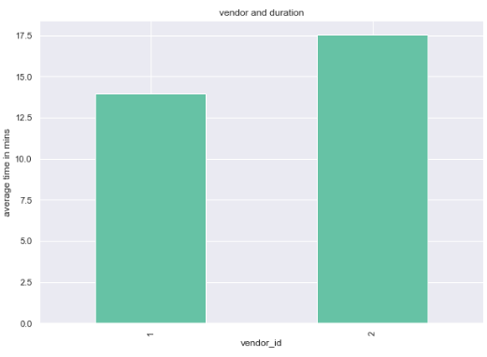
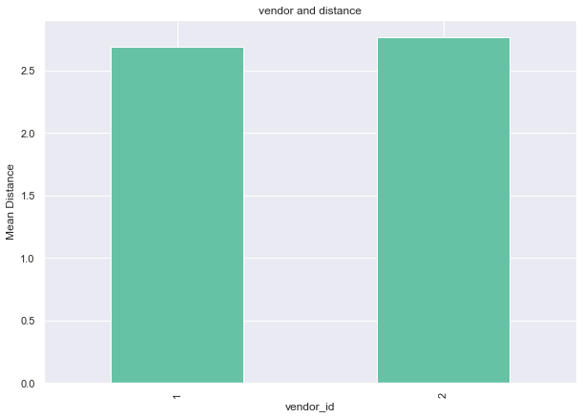
Trip Duration vs Vendor ID
Distance and Vendor ID
Notes:
Average trip duration for vendor 2 is higher than vendor 1 by approx 3 mins which is significant as proven through a t-test.

Slide 31

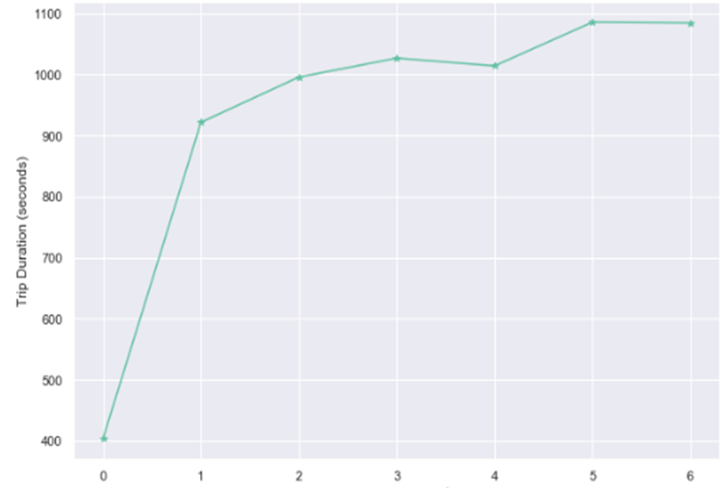
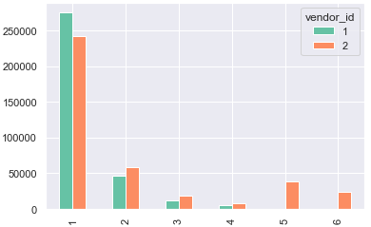
Vendor ID, Passenger Counts vs Trip Duration
Notes:
Vendor id 1 has more trip duration for one number of passengers
Vendor 2 has more duration for 2 passenger count
Looking further, we can see that there is a possibility that vendor 2 operates with high capacity cars.

Slide 32
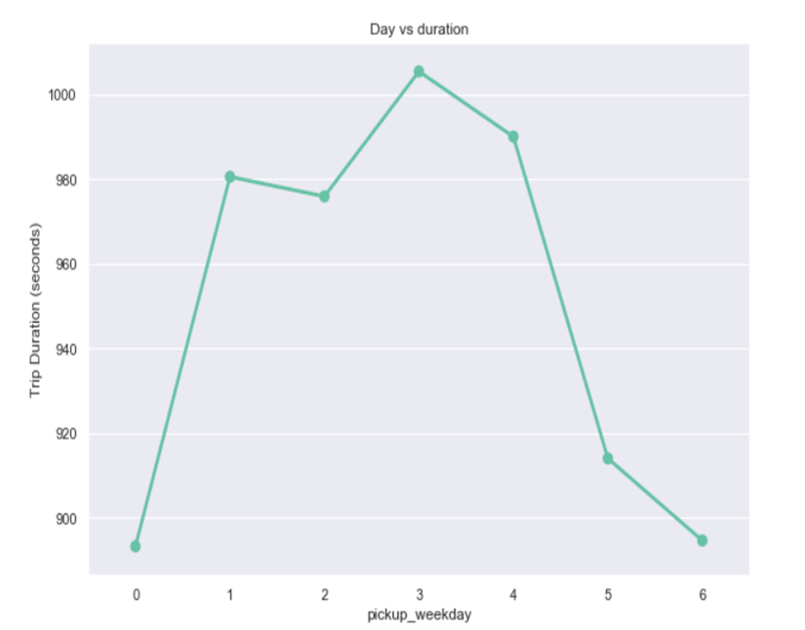
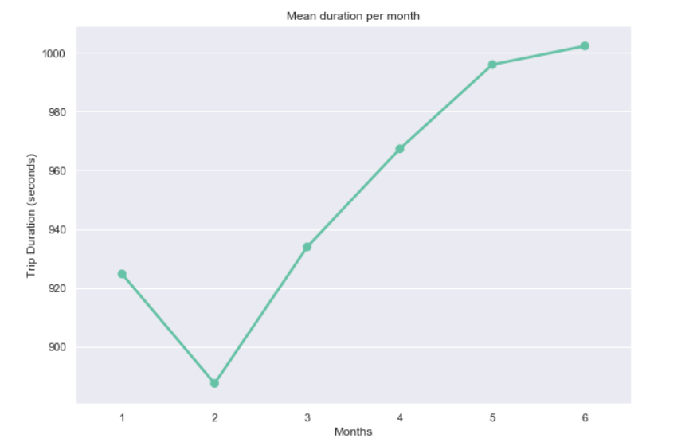
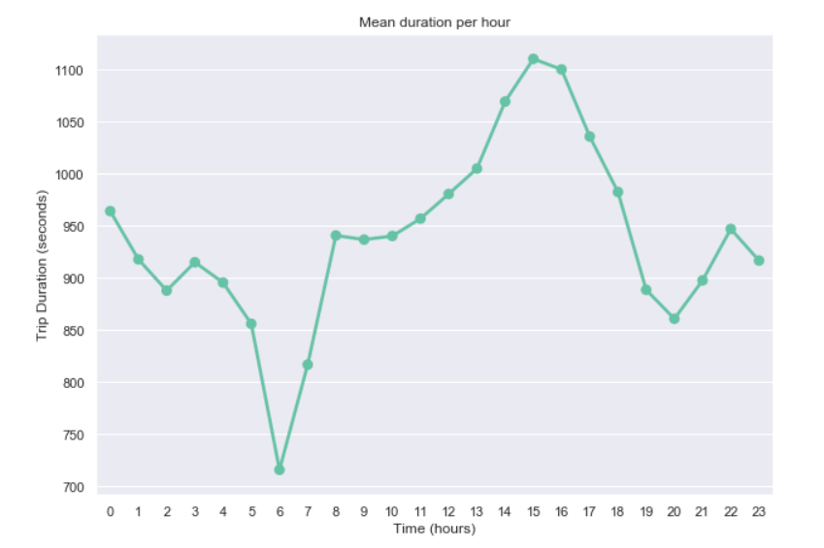
Day vs Duration
Mean Duration per Month
Duration vs Pickup Hours
Notes:
We can see a increasing trend here, with the mean duration increasing per month.
This might be due to Climatic conditions.
We can expect the duration to be longer in upcoming months rainy season start from July.

Slide 33
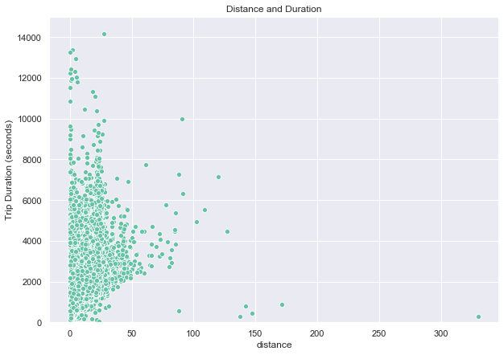
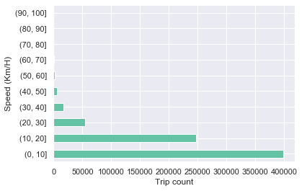
Distance Analysis
Speed Analysis
Notes:
More distance is covered during Sunday, might be due to outstation travels.
We can see a decreasing trend over the week day.

Slide 34
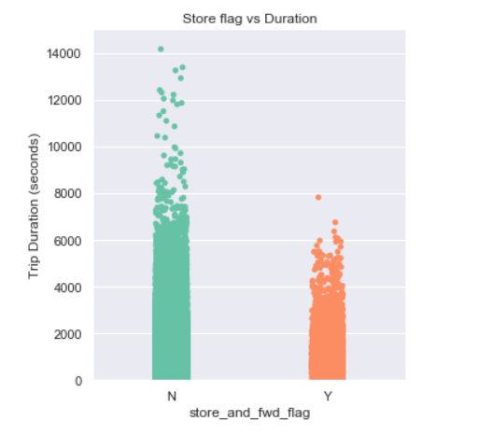
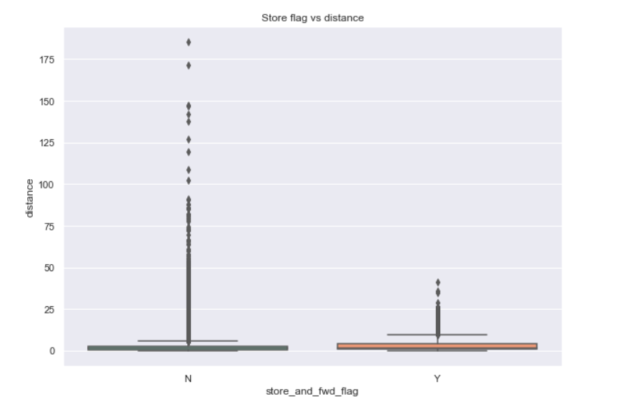
Store and Fwd Flag vs Duration
Store and Fwd Flag vs Distance
Notes:
Lesser number trips have store and forward flag has ‘YES’
Most of the trips with store flag as ‘YES’ are short duration trips and shorter distance trips.
This contradicts to our hypotheses.

Slide 35
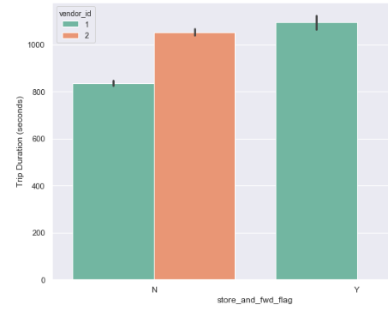
Store and Fwd Flag, Vendor ID vs Duration
Notes:
Only Vendor 1 has stored the and forwarded the flag.
This might be due to poor GPS machines used by vendor 1 or he takes m

Slide 36
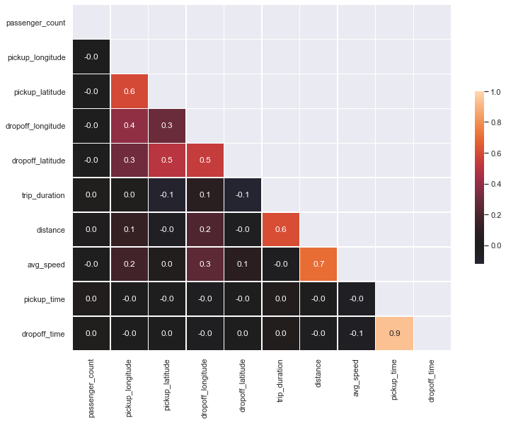
Correlation Heatmap
Notes:
There is not much correlation is seen with the target variable
Latitude and longitude has a high correlation with the target variable than other variables.

Slide 37
Summary of Bivariate Analysis-
1. Vendor 2 has more average trip duration as well as higher average distance than Vendor 1
Replacing the outliers/anomalies shows that as the passenger counts increase the duration too increases.
Vendor 1 is preferred for longer duration trips by 1 passenger count whereas for others 2 is preferred.
3. Week days have longer duration with a peak on Thursday and Friday.
Early morning trips are faster as expected and noon travels around 1PM to 5PM are longer.
Office hours are duration is lesser than noon and evening hours.
Increasing trend is observed on duration per month
Most of the trips are of shorter duration (1-10 kms).
4. We also see few anomalies with zero distance travelled and huge trip duration.
Also most trips have a speed between 0 to 30 kms/hr.
Shorter duration trips face connection issues.
Only Vendor 1 had this connection issue, this might be due to poor GPS machine used by them.
6. The correlation heat map shows that there is not much correlation among the independent and target variables, except for slight correlation among latitude and longitudes.

Slide 38
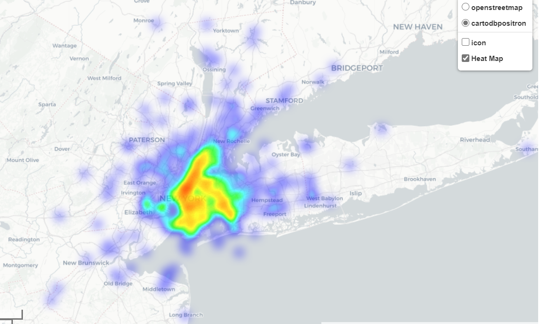
Latitude and Longitude vs Duration
We can see that Hotspots are more in Manhattan and Brooklyn
These areas seem to be the busiest in NYC

Slide 39
Models-
Results | Baseline Mean Model | Linear Regression (log transformed) | Linear Regression (Feature Selection) | Ridge Regression | Lasso Regression
RMSLE_Test | 0.901 | 0.878 | 0.868 | 0.864 | 0.857
RMSE_Test | 0.798 | 0.624 | 0.612 | 0.610 | 0.599
Notes:
Here we can see that the RMSLE score of our mean model gives the better result than others.
Also we can see that there is not much difference between the each mean model, as there is no strong correlation between each variables.

Slide 40
Conclusion
Lasso Regression performs the best on our dataset (for now) as we saw that the RMSE and RMSLE values came out to be the least for the same.
We need to look into more Machine Learning models which can capture our data better.
Notes:
Here we can see that the RMSLE score of our mean model gives the better result than others.
Also we can see that there is not much difference between the each mean model, as there is no strong correlation between each variables.

Slide 41
THANK YOU

Slide 42
Lasso Regression
Feature Selection
Pick_time_frame_Office Hours
Distance
Pick_time_frame_Noon Hours Pickup_day_name_Thursday
Pickup_month
Pickup_day_name_Wednesday Drop_time_frame_Evening
vendor_id
Pickup_time
Dropoff_month
Pick_time_frame_Night
Pick_time_frame_Evening
Pick_time_frame_Noon Hours
Pick_time_frame_Office Hours
dropoff_longitude
passenger_count_1
passenger_count_5
passenger_count_6
passenger_count_2
passenger_count_4
passenger_count_3
pickup_weekday
pickup_day_name_Thursday
pickup_day_name_Wednesday
pickup_day_name_Tuesday
pickup_day_name_Monday

